Slide 1
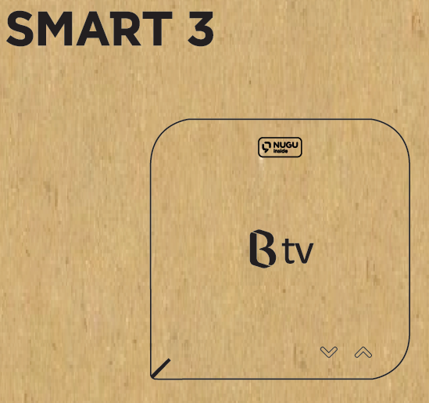
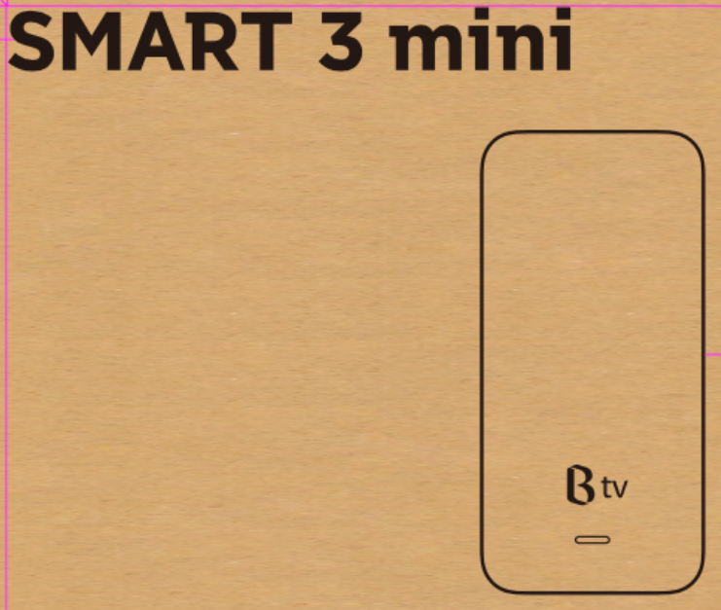


Slide 2






https://www.skbroadband.com/Main.do

Slide 3

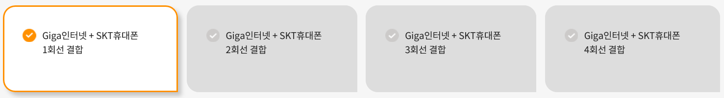
https://www.skbroadband.com/Main.do

